Slide 1

Investor Grievance Redressal Mechanism in Securities Market

Slide 2

DISCLAIMER
The information contained in this material is for only educational and awareness purposes related to securities market and shall be used for non-profitable educational and awareness activities for general public.
No part of this material can be reproduced or copied in any form or by any means or reproduced on any disc, tape, perforate media or other information storage device, etc. without acknowledging the SEBI or Stock Exchanges or Depositories.
SEBI or Stock Exchanges or Depositories shall not be responsible for any damage or loss to any one of any manner, from use of this material.
Every effort has been made to avoid errors or omissions in this material. For recent market developments and initiatives, readers are requested to refer to recent laws, guidelines, directives framed thereunder and other relevant documents, as being declared from time to time. For any suggestions or feedback, you may send the same to visitsebi@sebi.gov.in.
2

Slide 3
Flow of Presentation
SEBI Complaints Redress System (SCORES)
Investor Grievance Redressal at:
- NSE
- BSE Ltd.
- NSDL
- CDSL
3

Slide 4
SEBI Complaints Redress System
(SCORES)
4

Slide 5

SEBI COmplaints REdress System (SCORES)
SCORES platform: https://scores.gov.in
Online platform for investors to lodge their complaints
related to securities market.
Complaints against listed companies and
SEBI registered intermediaries
Status of every complaint:
Can be viewed online in the SCORES website
Can be obtained from toll free helpline
Entity/Investor can seek/provide clarification on complaint online
Unique complaint registration number for future reference and tracking.
All complaints received by SEBI against listed companies and SEBI registered intermediaries are dealt through SCORES.
5

Slide 6
Complaints coming under the purview of SEBI
Complaints arising out of issues that are covered under:
Securities Contract Regulation Act,
SEBI Act
Depositories Act
Rules and regulation made there under and relevant provisions of Companies Act, 2013.
6

Slide 7
Matters not considered as complaints in SCORES
Complaint not pertaining to investment in securities market
Anonymous Complaints (except whistleblower complaints)
Incomplete or un-specific complaints
Allegations without supporting documents
Suggestions or seeking guidance/explanation
Not satisfied with trading price of the shares of the companies
Non-listing of shares of private offer
Disputes arising out of private agreement with companies/intermediaries
Matter involving fake/forged documents
Complaints on matters not in SEBI purview
Complaints about any unregistered/ un-regulated activity
7

Slide 8
Complaints against companies that cannot be dealt on SCORES
Unlisted/delisted companies
Sick companies
Suspended companies, companies under liquidation, etc.
Vanishing company
Complaints that are sub-judice
Company falling under the purview of other regulatory bodies
Companies placed on Dissemination Board of Stock Exchange
Company where a moratorium order is passed in winding up / insolvency proceedings
8

Slide 9
Lodging complaint in SCORES
Lodge a complaint on SCORES within three (03) years from the date of cause of complaint.
                OR
Fail to lodge a complaint within Stipulated Time?
Take up the complaint with the entity concerned
Approach appropriate Court of Law
9

Slide 10
Lodging complaint in SCORES
Investor may lodge complaint on SCORES within three (03) years from date of cause of complaint, where;
Investor has approached listed company or registered intermediary for redressal of complaint and,
Concerned listed company or registered intermediary rejected the complaint or,
Complainant hasn’t received any communication from listed company or intermediary concerned or,
Complainant is not satisfied with reply given to him or redressal action taken by the listed company or an intermediary.
10

Slide 11
Mandatory information required
For lodging a complaint in SCORES, following personal information has to be mandatorily provided by investors/complainants:
Name
Address
E-mail Address
PAN
Mobile Number
11

Slide 12
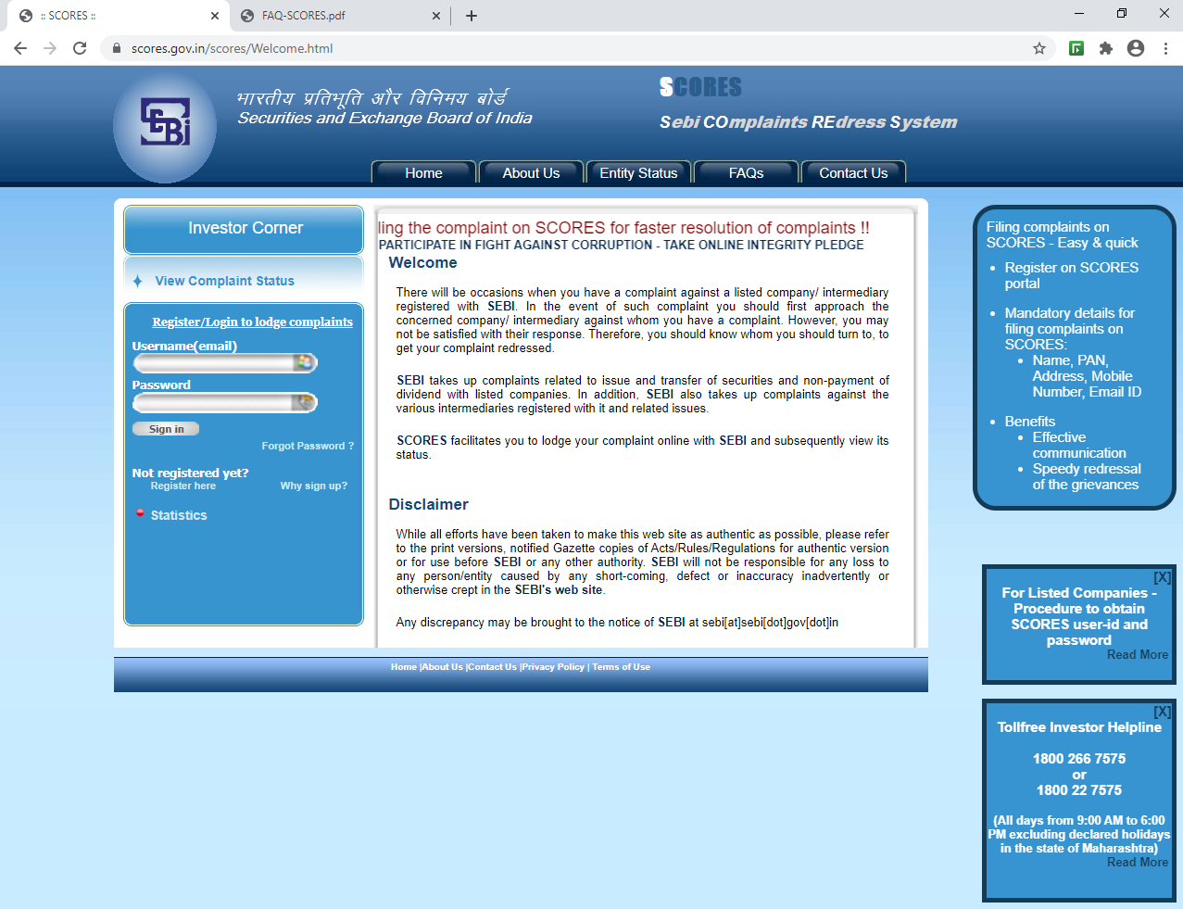
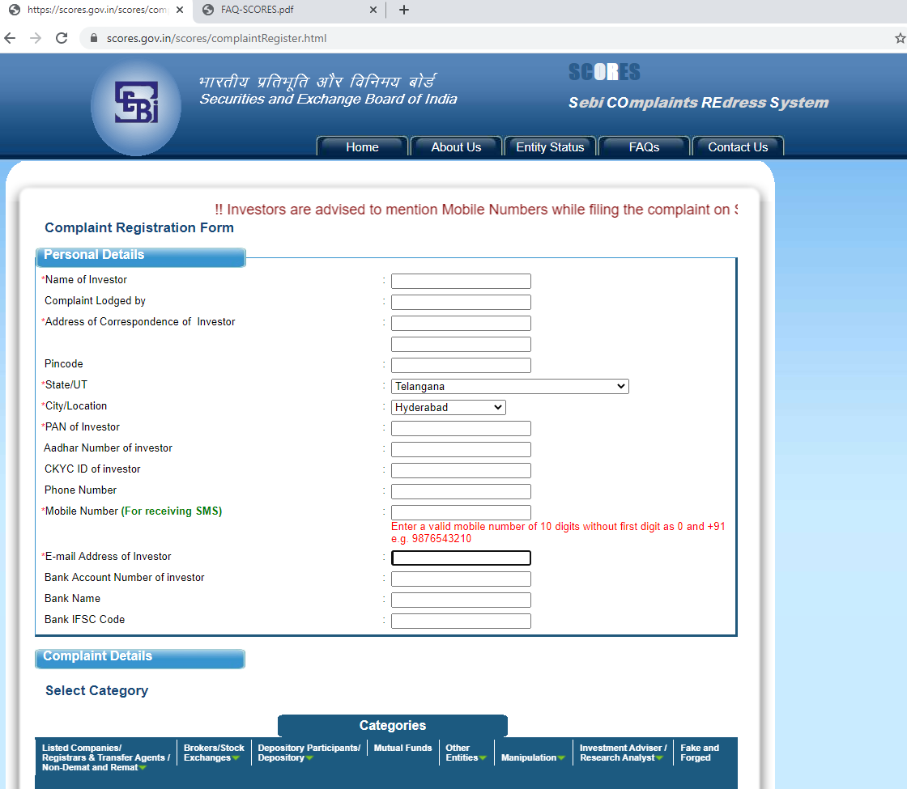
How to lodge complaint online in SCORES?
Visit SEBI SCORES website.
Register on SCORES before lodging a complaint.
SCORES Website Homepage
SCORES Complaint Registration Form
12

Slide 13
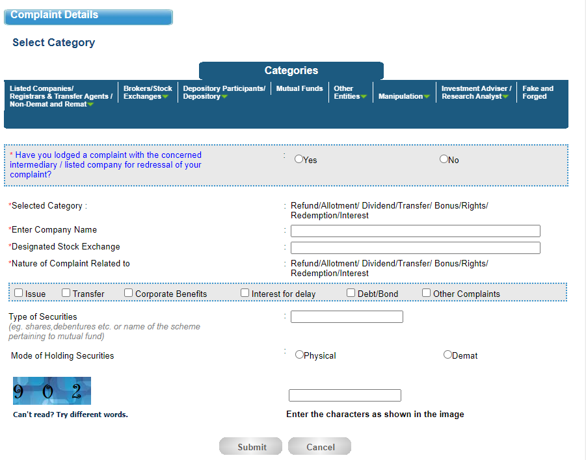
How to lodge complaint online in SCORES?
Provide complaint details in brief (up to 1000 characters).
PDF document (up to a maximum size of 2 MB) can also be attached along with complaint as supporting document.
Provide your complaint details.
Select correct complaint category, entity name and nature of complaint.
Complaint Details
13

Slide 14
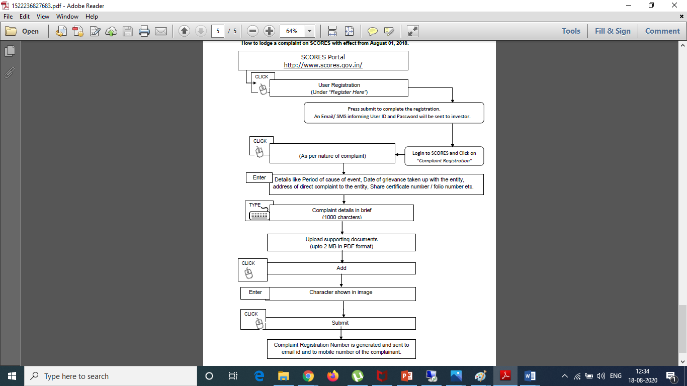
How to lodge complaint online in SCORES?
14

Slide 15
How are investor complaints handled? – Existing (Effective from August 01, 2018)
Have you taken up your grievances with the Company/ intermediary for resolution?
YES
NO
New User: Register here
Registered User: Login here
Redirected to complaint lodging screen on SCORES.
System shall enable the complaint to directly approach the entity (without intervention of SEBI officer) by using SCORES platform.
Submission of the complaint
Submission of the complaint.
Complaint lands in Inbox of SEBI dealing officer
Complaint shall land directly with the entity concerned.
Entity is required to submit details of redressal within 30 days.
Submitted
Not Submitted
System shall request the complainant to confirm within 15 days whether he is satisfied with resolution of the complaint.
Satisfied/ No Response
Not Satisfied
Complaint closed. No further Action
Complaint shall land in the inbox of SEBI dealing officer just like a regular complaint.
15

Slide 16
Disposing of Investor Complaints
Scenarios when SEBI disposes off complaints
On receipt of satisfactory action taken report along with supporting documents, if any, from the concerned entity responsible for resolving the complaint.
On failure by the investor/complainant to give complete details/documents required for redressal of their complaint within the prescribed time.
When the concerned entity’s case is pending with court/ other judicial authority.
16

Slide 17
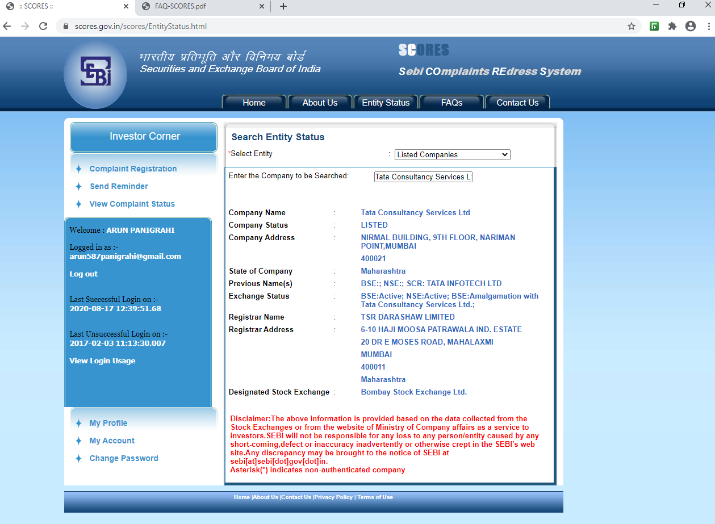
Entity Status in SCORES Website
Entity Status:
Available in entity status tab in SCORES Website.
Gives information regarding listed companies, SEBI registered intermediaries, CIS, etc.
17

Slide 18
SEBI SCORES App
Investor to first register on App to lodge complaints.
Facilitate lodging of investor grievances with SEBI.
Can be accessed at the convenience of a smartphone.
Enables investors to track status of the complaint redressal.
18

Slide 19
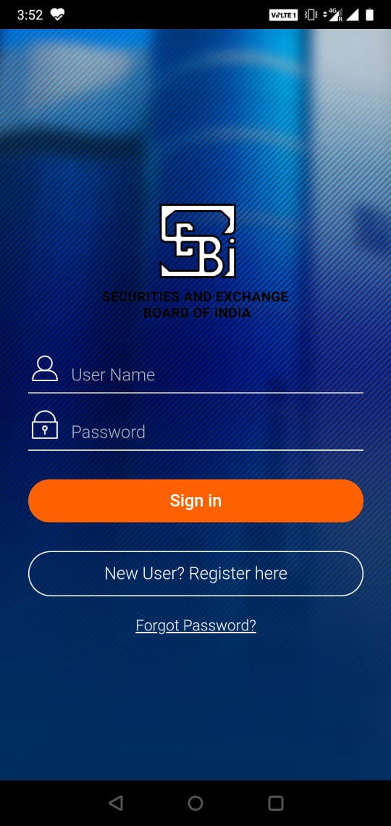
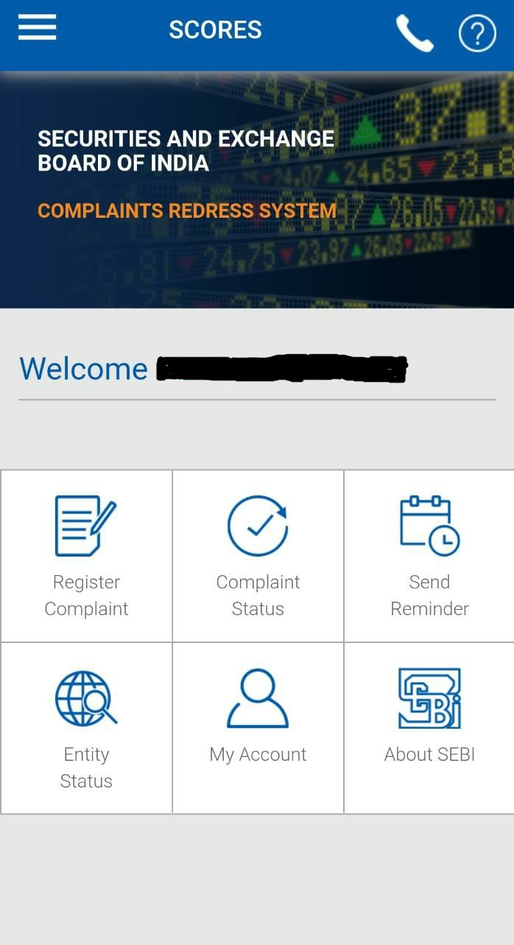
SEBI SCORES App
SCORES APP login page
SCORES Home page
19

Slide 20
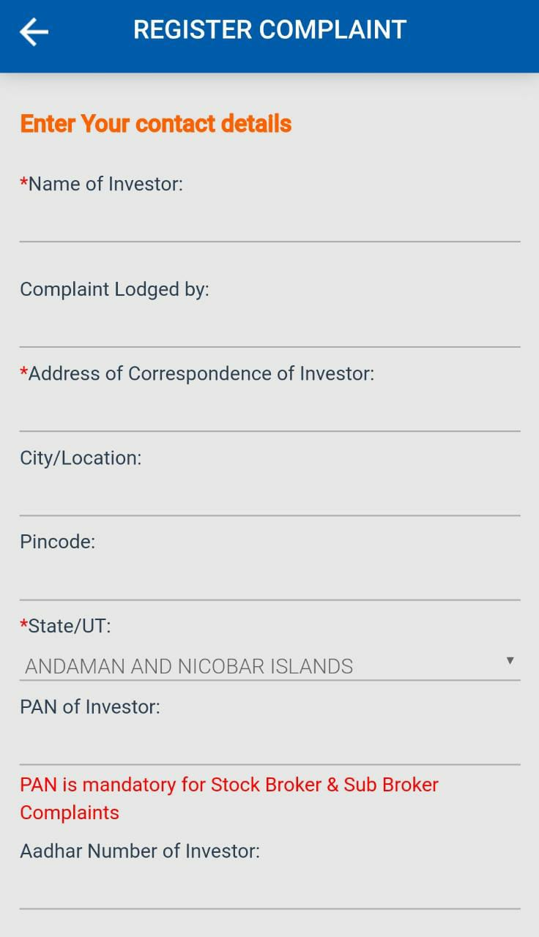
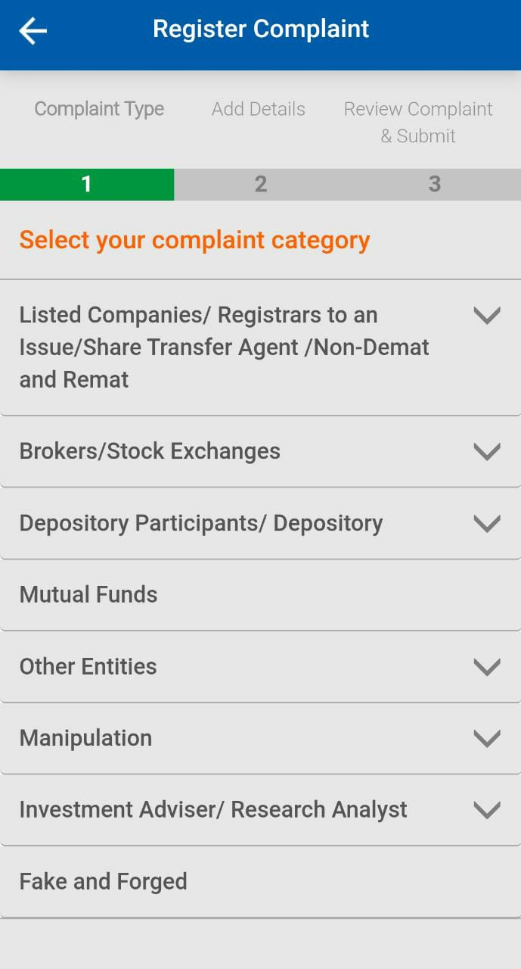
SEBI SCORES App
Register Complaint page
Register Complaint page
20

Slide 21

SEBI Toll Free Helpline
SEBI Toll Free Helpline Numbers:
1800 266 7575
1800 22 7575
Operational hours: 9:00 a.m. to 6:00 p.m.
[except public holidays declared in the state of Maharashtra]
Languages: 8
[English, Hindi, Bengali, Gujarati, Marathi, Kannada, Telugu and Tamil]
Objective: Facilitating replies to various queries of general public on matters relating to securities market
21

Slide 22
Regulators/Authorities for grievances not dealt by SEBI
Regulators/ Authorities | Grievances pertaining to
Reserve Bank of India (RBI)/ Banking Ombudsman | Banks deposits and banking products Fixed Deposits and other matters with Non-Banking Financial Companies (NBFCs) Primary Dealers
Ministry of Corporate Affairs(MCA) | Deposits u/s 73 & 74 of Companies Act, 2013 Unlisted companies Mismanagement of companies, financial performance of the company, Annual General Meeting, etc. Nidhi Companies Companies struck off from RoC Vanishing Company. All matters as delegated under overriding powers under Companies Act 2013 Sick companies or a company where a moratorium order is passed in winding up Companies under liquidation
22

Slide 23
Regulators/Authorities for grievances not dealt by SEBI
Regulators/ Authorities | Grievances pertaining to
Insurance Regulatory and Development Authority of India (IRDAI) | Insurance Companies / Brokers / Agents/ Products and Service
Pension Fund Regulatory and Development Authority (PFRDA) | Pension funds
Competition Commission of India (CCI) | Monopoly and anti-competitive practices
National Housing Bank (NHB) | Housing Finance Companies
Insolvency and Bankruptcy Board of India | Companies where insolvency proceedings has started
Respective Stock Exchange | Complaints against suspended companies
23

Slide 24
Investor Grievance Redressal - NSE
24

Slide 25

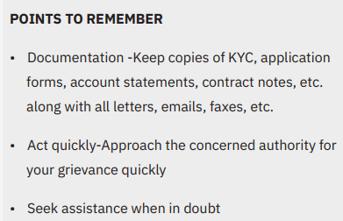
Investor Grievance Redressal (NSE)
Have a Dispute?
Immediately question your TM about any transaction that you do not understand or you did not authorize your trading member.
Not satisfied with your trading member’s response → Contact firm’s branch manager or customer care.
Any dispute with trading member → Complain in writing to trading member.
Retain copies of your letter and all related correspondence done with trading member.
Complaint not addressed/ redressed by the trading member →
File complaint with NSE
25

Slide 26
Investor Grievance Redressal (NSE)
Investor complaints against trading member and listed companies
Complaints can be filed by Investor via:
  Online portal of the Exchange: www.nseindia.com
  SCORES portal of SEBI
  Email
  Physical letter at any Investor Service Centre of the Stock Exchange/ Depository
  Complaint can be filed by investor at the nearest Investor Service Centre (ISC)
Investor Services Cell
Arbitration
Appeal Mechanism
Court of law u/s 34
26

Slide 27
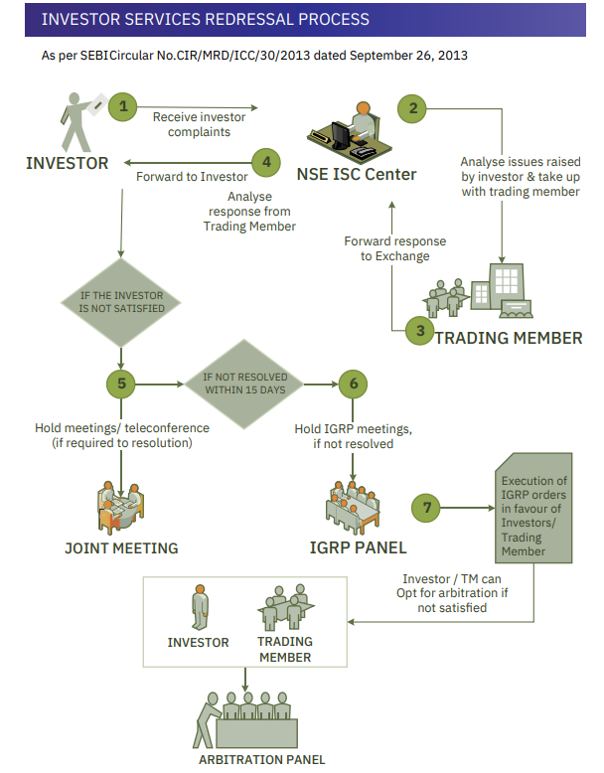
Investor Grievance Redressal (NSE)
27

Slide 28
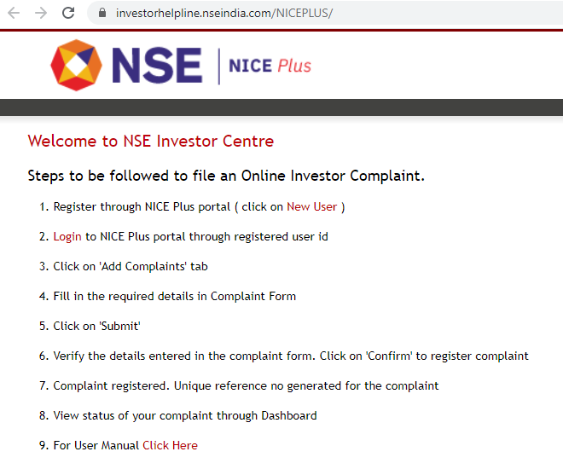
Online Medium to File Complaint (NSE)
NICE Plus online portal of Exchange to file complaint is available on the Exchange website https://www.nseindia.com/invest/file-a-complaint-online
28

Slide 29
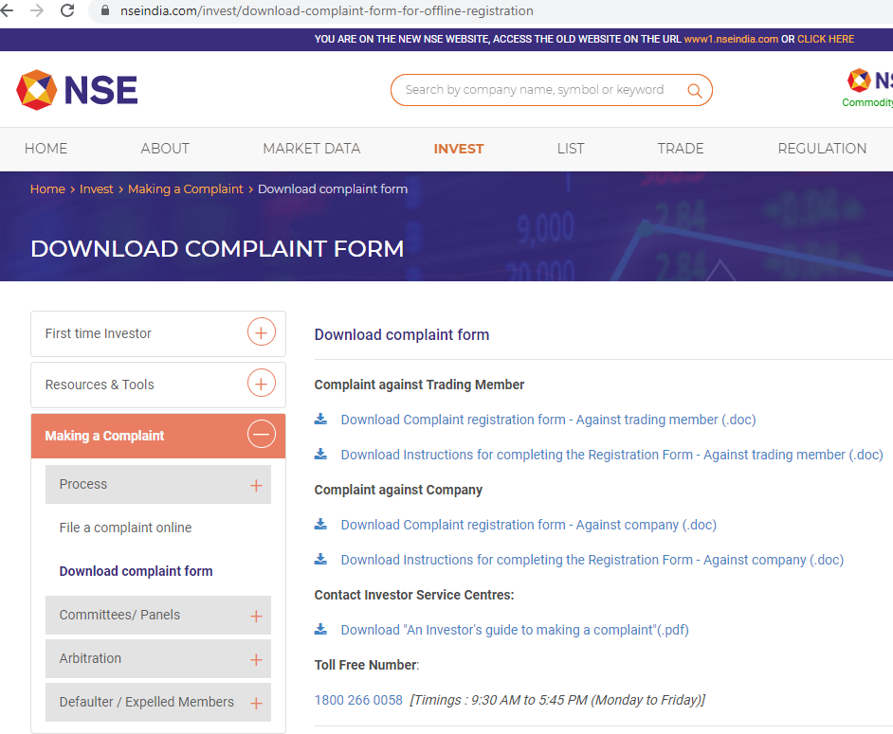
Offline Filing of Complaint (NSE)
Complaint can be filed offline by visiting nearest Investor Service Centre of the Exchange.
Details of Investor Service Centre of Exchange is available on the Exchange website, as shown below:
https://www.nseindia.com/invest/download-complaint-form-for-offline-registration
The relevant complaint forms are also available on the Exchange website
29

Slide 30
Complaint Resolution Process – Trading Member (TM) (NSE)
Analyze response from TM and then forward to Investor
Analyze issues raised by the investor & take up with trading member
Receive investor complaints
Hold meetings /teleconferencing
Resolve the complaint. If not resolved, hold GRC meeting.
30

Slide 31

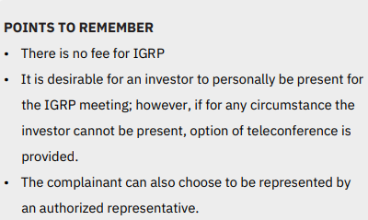
Investor Grievance Resolution Panel (IGRP)
(NSE)
Complaints which do not get resolved within 15 days of lodging on Exchange
Where parties are aggrieved by the resolution worked out.
Referred to Investor Grievance Resolution Panel
31

Slide 32
Investor Grievance Resolution Panel (IGRP)
(NSE)
Investor Grievance Resolution Panel:
Consists of retired external persons (who are not in full time employment).
Redresses complaints and accordingly passes order.
Constituted by Exchange at each of the Investor Services Cell (ISC)
The members on IGRP may be referred from below web-link:
https://www.nseindia.com/invest/investor-grievance-resolution-panel
Order in favor of investor, NSE →
Blocks amount from available deposits of the trading member with NSE
Pays the investor in case trading member decides not to file arbitration.
Trading Member decides to file arbitration →
An interim amount released to investor from the Investor Protection Fund (IPF).
32

Slide 33
Investor Service Centres (ISC)
(NSE)
Jammu
Chandigarh
Shimla
MUST KNOW:
5 Regional Offices (RO)
19 Investor Service Centres (ISCs)
TM complaint resolution and Arbitration is serviced from ROs & ISCs
Delhi
Dehradun
Jaipur
Lucknow
Guwahati
Kanpur
Ahmedabad
Vadodara
Indore
Patna
Kolkata
HO
WRO
Ranchi
Raipur
Bhubaneshwar
Pune
Hyderabad
Panaji
Bangalore
Chennai
Cochin
33

Slide 34
Grievance Redressal Committee (GRC) - Conciliation process (NSE)
Investor or trading member can opt for Arbitration, if not satisfied
Implementation of GRC orders in favor of investors
Hold Grievance Resolution Committee meeting
Cost of conducting conciliation is entirely borne by the Exchange
Go through records
Analyze the complaint
Hear both the parties
Opportunity for both parties to represent their case
Discuss for redressal
Record admissibility of claim value
Detailed discussion and/or clarification
Prepare order mentioning admissible claim value
34

Slide 35
Arbitration (NSE)
What is ARBITRATION?
- Quasi Judicial process of settlement of disputes between trading member, investor.
Arbitration Matters handled from all 24 centers.
Governed by Board sub-committee: Regulatory Oversight Committee.
Claim value up to Rs.10 lakhs→ Arbitration fees borne by Exchange
Centralized Arbitrator Appointment Process (CAAP)- for selection of Arbitrator.
Mechanism of Appellate Arbitration, also available.
35

Slide 36
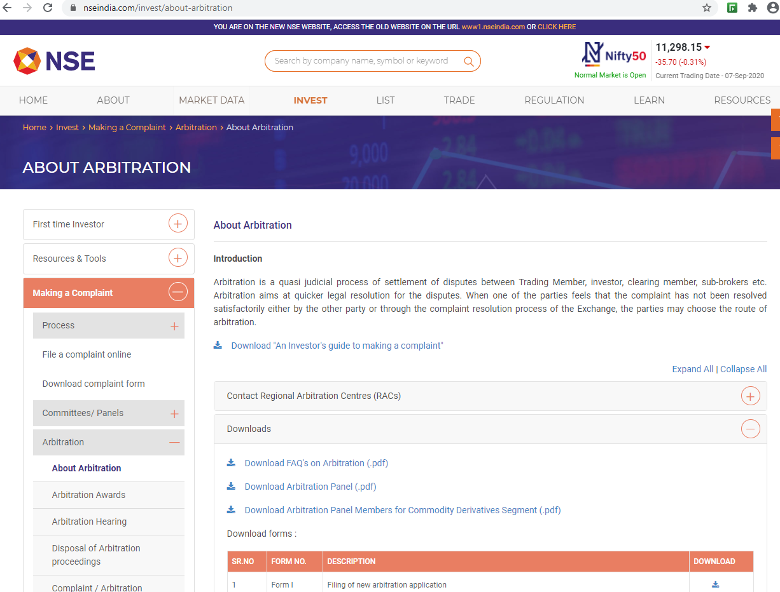
Arbitration (NSE)
Filed online using NICE Plus portal.
Forms for Arbitration / Appellate available on Exchange website:
https://www.nseindia.com/invest/about-arbitration
Panel of Arbitrators available region wise disclosed on the website on below link:
https://www.nseindia.com/invest/arbitration-panel
36

Slide 37
Arbitration Process (NSE)
Hearings held by arbitrator
Arbitrator appointed through CAAP and documents forwarded
Application is verified and sent to Respondent
Applicant submits arbitration application to Exchange
Hearings held and appeal award passed
Arbitrator passes award
Appeal filed by aggrieved party
Award debited if in favor of constituent
Petition filed u/s 34 in Court
37

Slide 38
Arbitration Process – Important points
(NSE)
Activity |  | Details
Arbitration application to be filed within |  | Three years from date of dispute.
Arbitration application to be filed at |  | Regional Arbitration Centre (RAC) nearest to investor’s address mentioned in KYC.
Arbitrators | Value of Claim up to Rs.25 lakhs | Sole Arbitrator
 | Value of claim > Rs.25 lakhs | Panel of three Arbitrators
Selection of Arbitrator |  | Through Centralized Arbitrator Appointment Process (CAAP) across Exchanges
38

Slide 39
Arbitration Process – Important points
(NSE)
Activity | Details
Hearing in arbitration cases | Conducted by Arbitrator with the parties and judgement is passed in form of award. For claim amount < Rs.25,000/-, hearing isn’t compulsory, but arbitrator may call for hearing, if required.
Awards announced by Arbitrator | Awards in favor of investor implemented by NSE. Amount, as above, taken from trading member and paid to investor.
Non-satisfactory redressal | Investor/ TM not satisfied with arbitration award may file an appeal. Interim amount is paid out of IPF to investor, if TM wishes to appeal further in appellate arbitration.
39

Slide 40
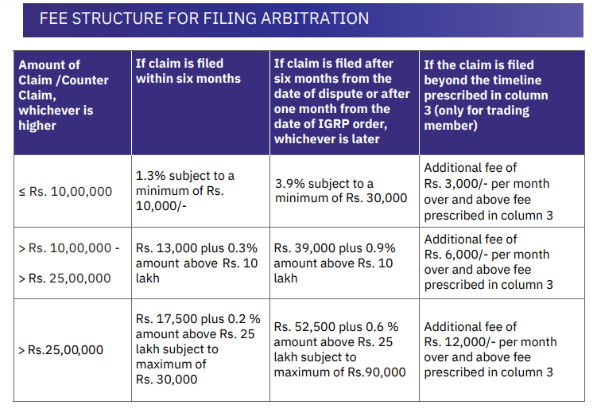
Fee Structure for Filing Arbitration (NSE)
40

Slide 41
Forms/ Documents for Filing Arbitration application (NSE)
Different forms/ documents used for filing arbitration application:
S.No. | Forms/ Documents | Purpose
1. | Form III (dated & signed) | For filing appeal against the award passed along with copy of award.
2. | Statement of appeal | Brief description of the grounds which are to be placed in the appeal and relief sought through the appeal process.
3. | Cheque/ Pay Order/ Demand Draft in favour of NSEIL | Towards cost of appeal (non-refundable)
* Note: The documents should be submitted in sets of 5 in original.
41

Slide 42
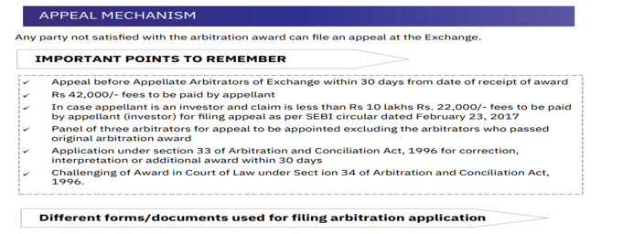
Investor Grievance Redressal (NSE)
S.No. | Forms/ Documents | Purpose
1. | Form III (dated & signed) | For filing appeal against the award passed along with copy of award.
2. | Statement of appeal | Brief description of the grounds which are to be placed in the appeal and relief sought through the appeal process.
3. | Cheque/ Pay Order/ Demand Draft in favour of NSEIL | Towards cost of appeal (non-refundable).
* Note: The documents should be submitted in sets of 5 in original.
42

Slide 43
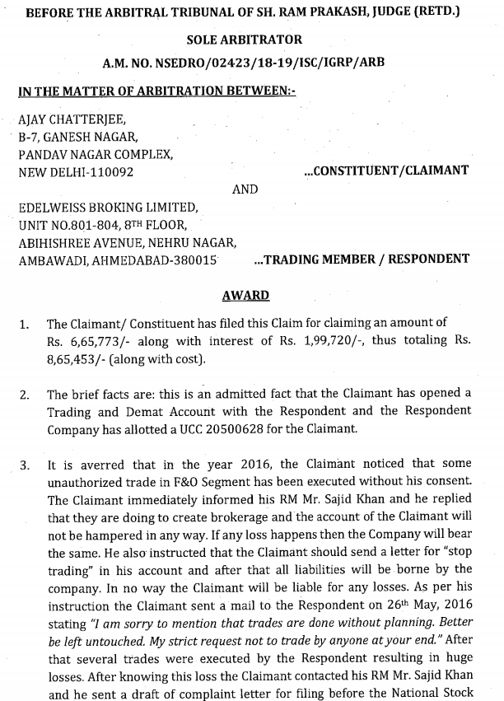
Sample Arbitration Award Copy (NSE)
43

Slide 44
Arbitration Process – Interim Relief to small investors (NSE)
Interim Relief granted to clients by Stock Exchange (SE) from Investor Protection Fund (IPF), if:
  Order of award is in favor of client.
  Member opts for further appeal
  Claim value admissible is not more than Rs.20 lakhs
Total amount released to client through facility of interim relief from IPF shall not exceed Rs.10 lakhs in the financial year.
Condition | Interim Relief
TM files Arbitration against GRC order | 50% of the admissible claim amount or Rs.2 lakhs, whichever is less
TM opts for Appellate / Court against Arbitration | 50% of the award amount or 3 lakhs, whichever is less
TM files appeal in Court against Appellate Award | 75% of the appellate arbitration award or 5 lakhs, whichever is less
44

Slide 45
Remedy to investors in case of Broker – Expulsion/ Default (NSE)
Defaulters’ Committee:
Administer assets in respect of defaulters/expelled trading members.
Distributes amount available in defaulter's account to the admitted claims on pro-rata basis as per the priority laid out under NSE Rules / Regulations / Bye-Laws
In case of insufficient funds in Defaulters' account →
Compensation is paid from Investor Protection Fund (IPF)
Compensation up to a maximum of Rs.25 lakhs per investor subject to an overall limit per defaulter / expelled member.
45

Slide 46
Remedy to investors in case of Broker – Expulsion/ Default (NSE)
Trading Member expelled/ declared as defaulter/expelled member →
Exchange issues a Public Notice in leading newspapers.
List available on NSE website under:
Home > Domestic Investors > Defaulters > Public Notice.
Investors having claims against Defaulter/Expelled Trading Member:
Register claim within 3 months from date of Public Notice.
To register a claim against a defaulter/expelled Member:
  Visit www.nseindia.com website
  Download form from below mentioned address:
  https://www.nseindia.com/invest/details-to-be-provided-for-lodging-claims
46

Slide 47
Investor Grievance Redressal - BSE
47

Slide 48
Investor Grievance Redressal (BSE)
Department for Investors Services (DIS)
Dedicated department to redress investor grievances.
Operation of Investor Services Center (ISC) commenced in year 1986.
Plays a pivotal role in enhancing and maintaining investors' faith and confidence by resolving their grievances.
Services offered by DIS are as under:
  Investors' Grievances against BSE's Trading Members (Including Arbitration & appellate Arbitration)
  Claim against Defaulter/Expelled Member
  Investors' Grievances against Listed Companies
  Regional Investor Service Centers of BSE = At 25 places.
  Complaint against Companies are handled solely from Mumbai office (Fort & BKC).
48

Slide 49
Mode of Filing Complaints (BSE)
Physical Complaint
Filing of complaints at concerned regional investor centre of BSE Ltd.,
List of Investor Service Centers available at: https://www.bseindia.com/static/investors/cac_tm.aspx
Email
Lodging complaints through email on dedicated email id of exchange at: https://www.bseindia.com/static/investors/cac_tm.aspx
eComplaint Portal
Lodging of complaints through Exchange’s website under e-Complaint Registration at following link: https://bsecrs.bseindia.com/ecomplaint/frmInvestorHome.aspx
SCORES
Lodging of complaints on SEBI SCORES.
49

Slide 50

Investor Service Centres (ISCs) offering IGRC & Arbitration Facility (BSE)
25 ISCs PAN INDIA
Ahmedabad
Bengaluru
Bhubaneshwar
Chandigarh
Chennai
Dehradun
Guwahati
Hyderabad
Indore
Jaipur
Jammu
Kanpur
Kochi
Kolkata
15) Lucknow
16) Mumbai (2)
17) New Delhi
18) Panjim
19) Patna
20) Pune
21) Raipur
22) Ranchi
23) Shimla
24) Vadodara
50

Slide 51
Investor Grievance Redressal (BSE)
Process of IGRC, arbitration and appeal is same as that of NSE.
Investors to approach nearest Regional Investor Service Centre w.r.t. the most recent address / registered office address of the constituent.
Hearings shall be held in concerned Regional Investor Service Centre where the Applicant has filed the Application for IGRC/Arbitration.
For complaints arbitration forms, fees structure, arbitrators profile:
https://www.bseindia.com/static/investors/arbitration_mechanism.aspx
For details of complaint/ Arbitration status:
https://www.bseindia.com/investors/invgrievstats.aspx
For the Arbitration awards:
https://www.bseindia.com/investors/ArbitAwards.aspx
51

Slide 52
Investor Claim against Defaulter/ Expelled Member (BSE)
Maximum of Rs. 15,00,000/- be compensated to client of a defaulter.
Compensation paid from Investors Protection Fund (IPF).
Amount paid to extent of award amount or Rs. 15,00,000/-, whichever is lower.
Exchange website may be accessed for:
Norms for eligibility of claims for compensation from IPF.
Form for lodging claim against Defaulter/Expelled Member.
Checklist for lodging claims
https://www.bseindia.com/static/investors/cac_tm.aspx
52

Slide 53
Investor Grievance Redressal - NSDL
53

Slide 54

Investor Grievance Redressal (NSDL)
Have a Grievance related to Demat account?
Approach Depository Participant (DP) where you hold your demat account.
Grievance not resolved by DP → Approach your Depository
Lodge complaint to NSDL through:
NSDL Toll Free helpline
1800 222 990
NSDL Email for grievance
relations@nsdl.co.in
NSDL email for other information
info@nsdl.co.in
Online submission of Grievances at www.nsdl.co.in
→Query Now
54

Slide 55
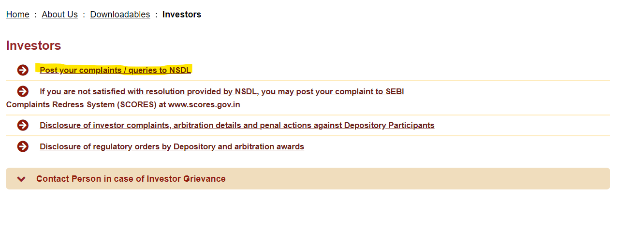
Online Submission of Grievances (NSDL)
55

Slide 56
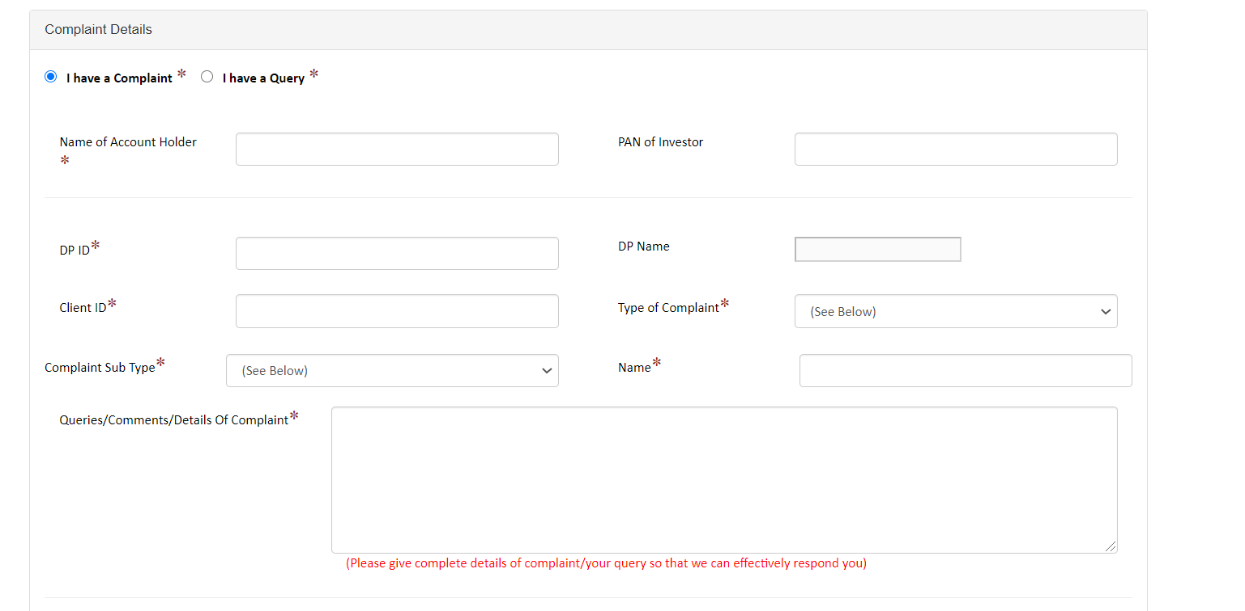
Online Submission of Grievances (NSDL)
56

Slide 57
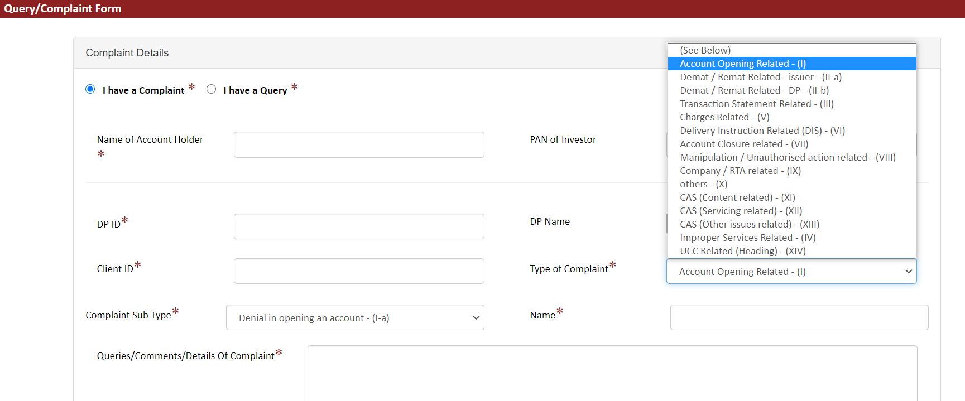
Online Submission of Grievances (NSDL)
57

Slide 58
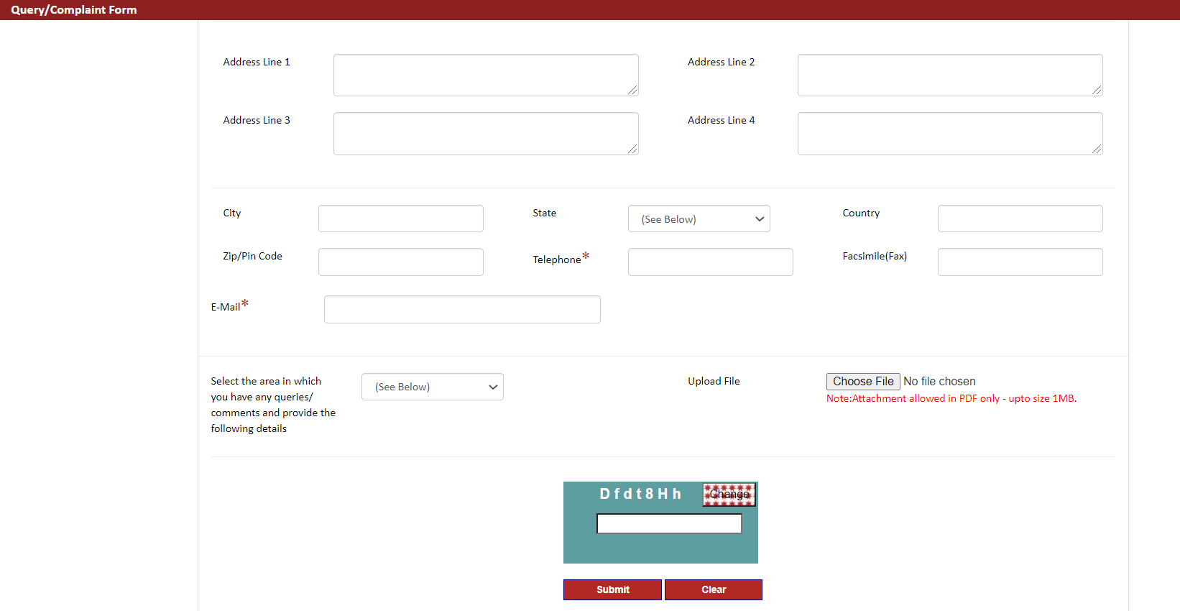
Online Submission of Grievances (NSDL)
58

Slide 59
Investor Grievance Redressal - CDSL
59

Slide 60
Investor Grievance Redressal (CDSL)
Lodge complaint to CDSL through:
Have a Grievance?
Approach Depository Participant (DP) where you hold your demat account.
If grievance not resolved, approach your depository.
CDSL Web portal: https://www.cdslindia.com/Footer/grievances.aspx → Post your Grievances
- For complaints against Depository Participants (DPs) and Registrar and Transfer Agents (RTAs)
CDSL Email id : complaints@cdslindia.com
CDSL Toll Free no : 1800-22-5533
Trading/Broking related grievance → take up with Broker/Trading Member
60

Slide 61
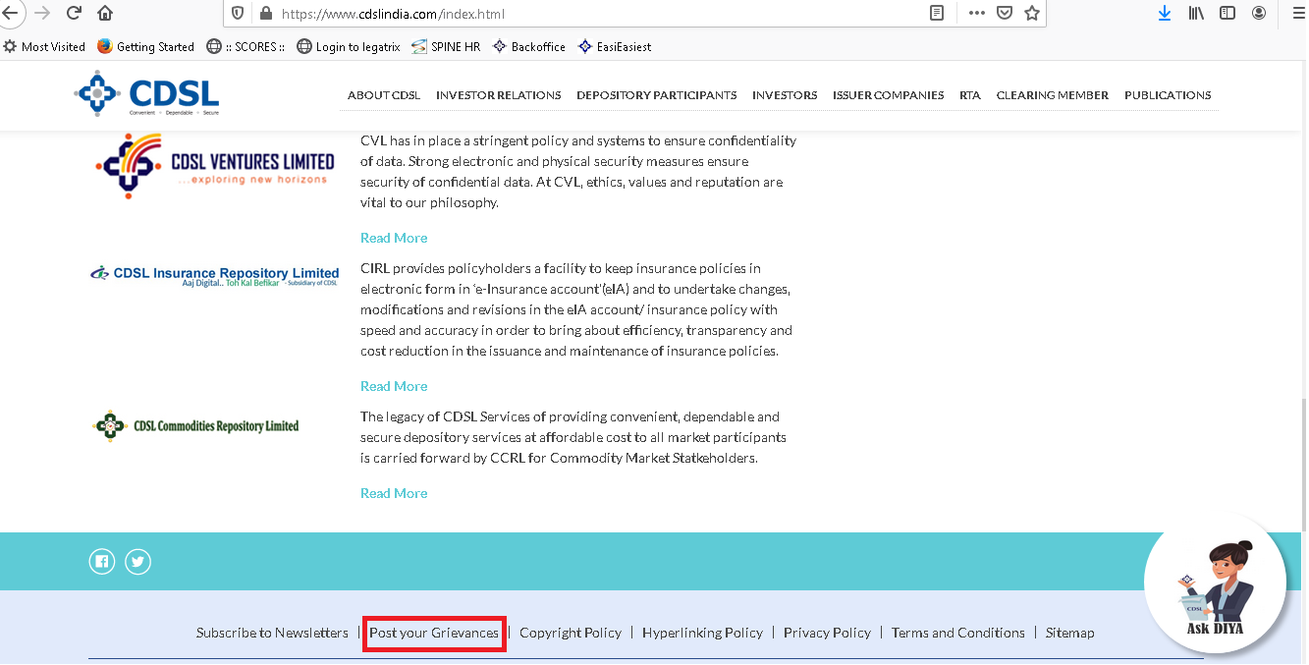
Registration of Grievance through CDSL Web based Portal
To register your Complaint
Visit www.cdslindia.com
Click on option Post your Grievance
Contd…
61

Slide 62
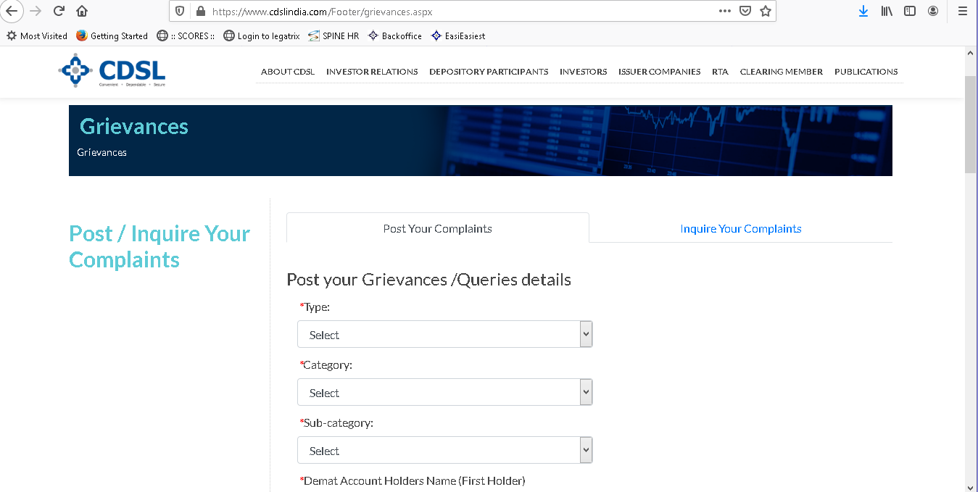
Registration of Grievance through CDSL Web based Portal (contd…)
After clicking on Post your Grievance
Enter details of grievance like type, category, sub-category, PAN, contact number, complaint against and complaint details
Contd…
62

Slide 63
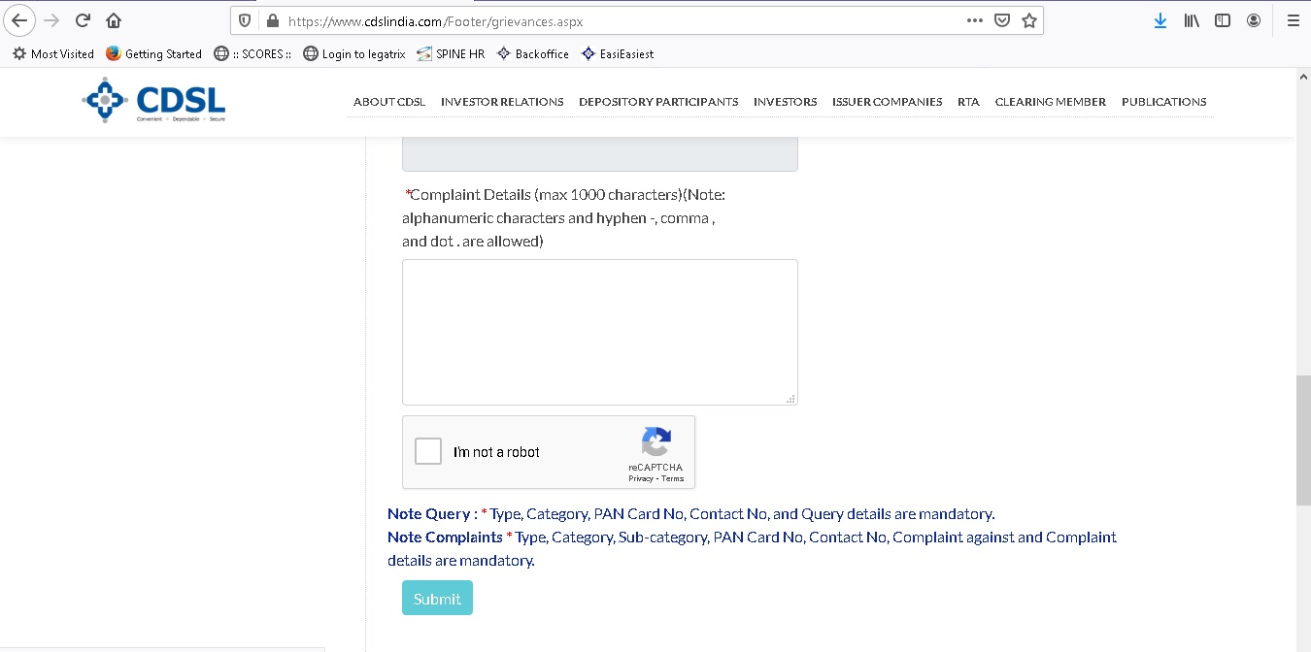
Registration of Grievance through CDSL Web based Portal (contd…)
After entering mandatory details, click on Submit option.
Enter the OTP received on your registered email-id.
Grievance will be registered and grievance registration number will be flashed on screen.
Contd…
63

Slide 64
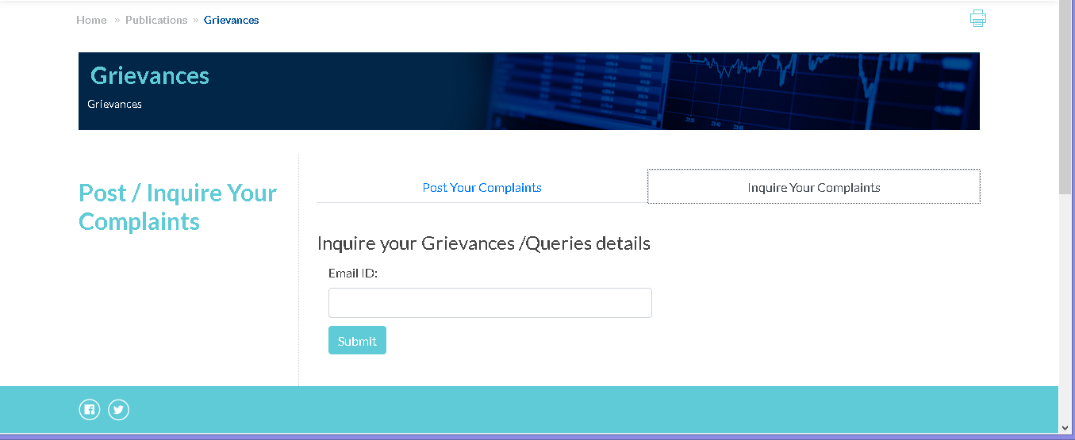
Registration of Grievance through CDSL Web based Portal (contd…)
Complaint forwarded to respective DP/ RTA for redressal.
Status of grievance may be checked from – Inquire your Complaints.
Contd…
64

Slide 65
Websites of SEBI and Stock Exchanges and Depositories
SEBI: www.sebi.gov.in
SEBI SCORES: www.scores.gov.in
Stock Exchanges:
  NSE Ltd: www.nseindia.com
  BSE Ltd: www.bseindi.com
  MSE: www.msei.in
  Depositories:
      NSDL: www.nsdl.co.in
      CDSL: www.cdslindia.com
65

Slide 66
Thank You
66

